Slide 1
LEADING WITH PURPOSE IN TURBULENT TIMES
@ZMERCURIO
Zach Mercurio, Ph.D.
Author, “The Invisible Leader”
Honorary Fellow, Center for Meaning and Purpose Colorado State University
Zach@ZachMercurio.com
@ZACHMERCURIO
@ZACHMERCURIO
@ZACHMERCURIO
Notes:
Welcome, Zoom details, chat, then Q&A, first name, one word to describe how you’re doing right now

Slide 2
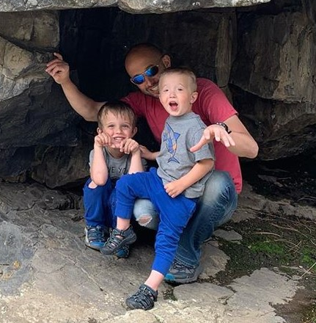
@ZACHMERCURIO

Slide 3
@ZACHMERCURIO

Slide 4
@ZACHMERCURIO

Slide 5
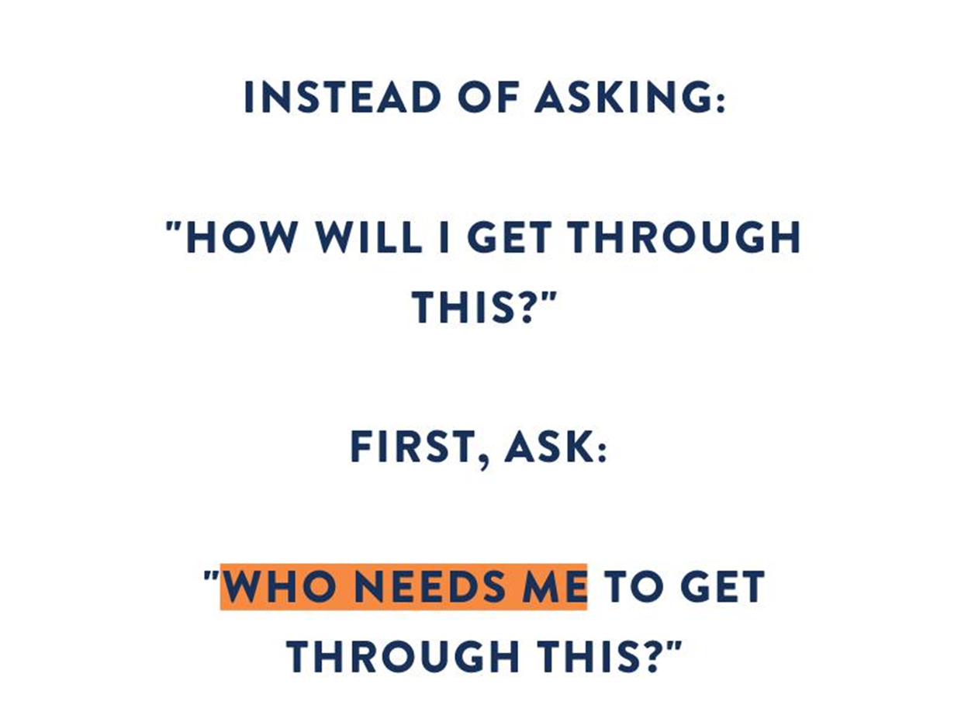
@ZACHMERCURIO

Slide 6
Purpose (n.): The reason for which something is done or created or for which something exists.
@ZACHMERCURIO

Slide 7
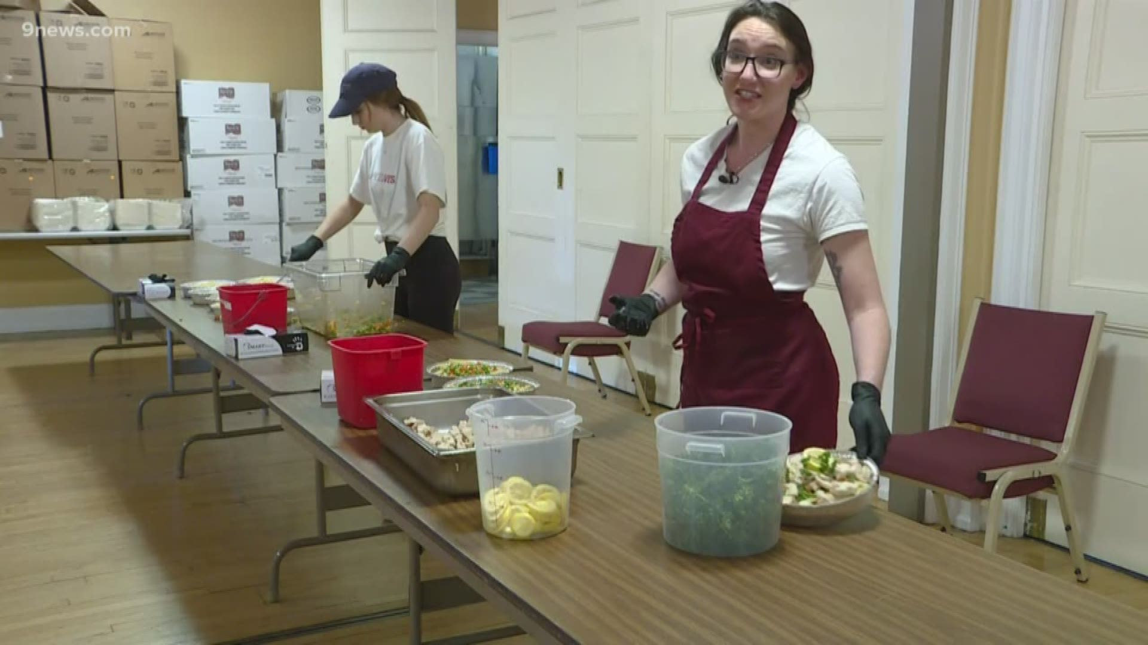
@ZACHMERCURIO
Notes:
This made me especially susceptible to what University of Michigan researcher Jennifer Crocker called making “self-image” goals – pursuing acquiring and achieving things to make me and my life “look” good. In other words, as the NYT columnist David Brooks termed them “resume” virtues. The opposite of self-image goals are compassionate goals. The opposite of resume virtues are eulogy virtues, the things you want said about you at your funeral, the worthy contributions you made.
But that’s largely how I was educated and is how most of us are educated and how we educate others – for “success.” Get this and you’ll be happy.
Or, in organizations, “give them this” and they’ll be happy.
I was educated for “success” – get a good job, a Nintendo Wii, a steady paycheck, status, basically all of the things except what researchers know makes life worth living.
Now, spoiler alert, researchers find, especially in workplaces, that making too many these self-image or achievement-oriented goals often leads to very problematic outcomes like low self-esteem, anxiety, combative relationships, making poor choices, and the experience of meaninglessness.
The reason is that when we’re primarily motivated by achievements, we can achieve them. And we’re perpetually scratching and clawing for the next achievement to give us worth.
Cue Zach Mercurio in his early 20s.

Slide 8
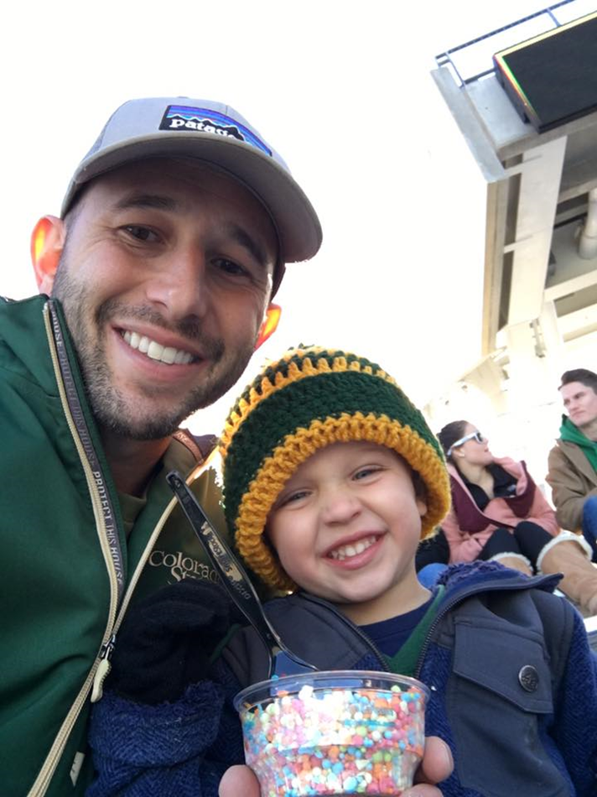
Notes:
MEET ELLEN BECKER (ELLEN STORY)

Slide 9
The Effect of Being Purposeful
4
#1
50
Times more engaged at work.
Factor in job satisfaction.
% more likely to be promoted
7
42
2
Average number of years longer people with purpose live
% more likely to experience regular contentedness
times more likely to learn something new every day
Sources: Hill, 2014; Leider, 2015, NYU, 2016, LinkedIn, 2017
@ZACHMERCURIO

Slide 10
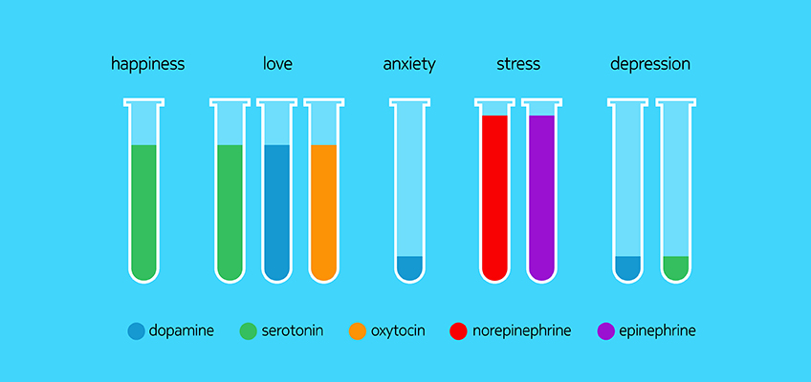
When we think about our impact on others or actively help others
Sources: Dunn, Aknin, & Norton, 2008
@ZACHMERCURIO

Slide 11
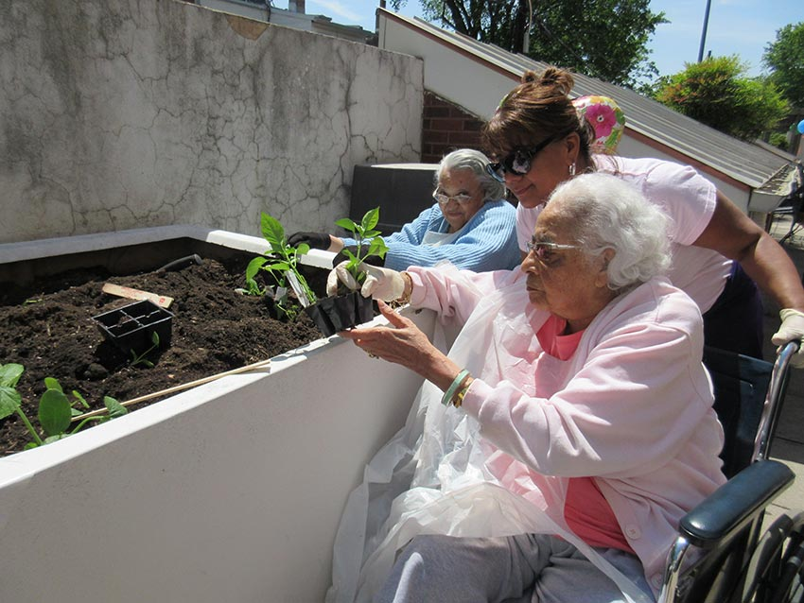
Twice as many residents who were tasked with “keeping a plant alive” were alive after 18 months than the control group.
Sources: Rodin & Langer, 1977
@ZACHMERCURIO

Slide 12
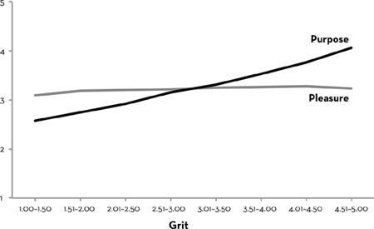
Source: Duckworth, 2016, “Grit: The Power of Passion and Perseverance”
@ZACHMERCURIO
@ZACHMERCURIO

Slide 13
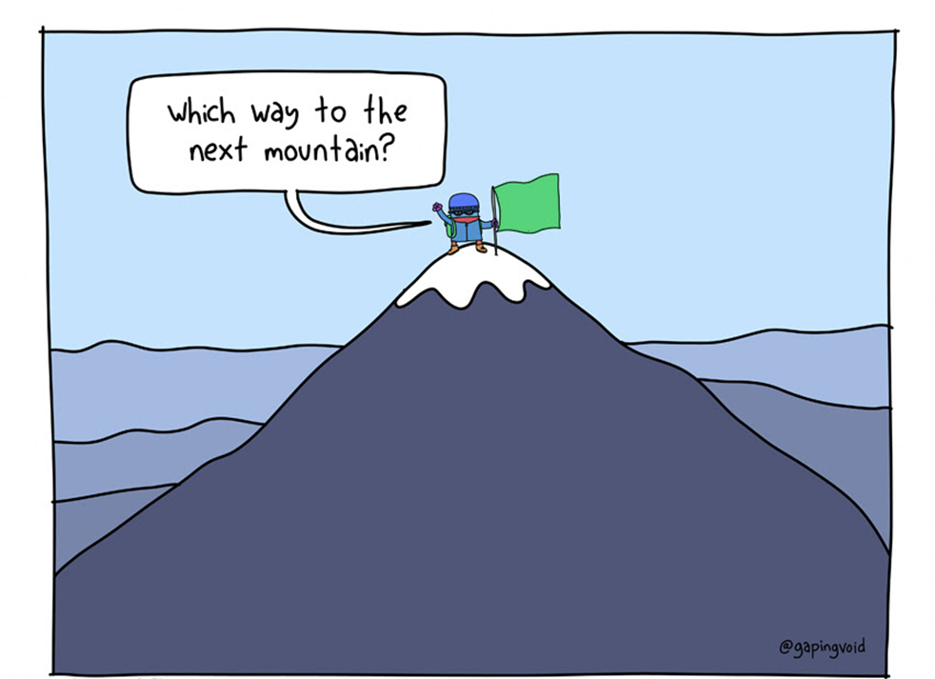
Source: Gaping Void Culture Design Group, 2019
@ZACHMERCURIO
@ZACHMERCURIO

Slide 14
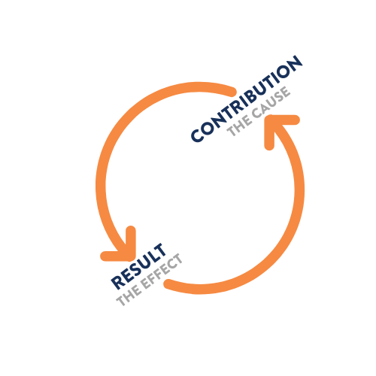
@ZACHMERCURIO
@ZACHMERCURIO

Slide 15
FOCUS
EXTERNAL PRESSURE(S)
WHAT
WHY
TIME
@ZACHMERCURIO
@ZACHMERCURIO

Slide 16
Key Practices of Purposeful Leaders
Show people how they matter
Communicate and connect people to your purpose
Practice your purpose
@ZACHMERCURIO

Slide 17
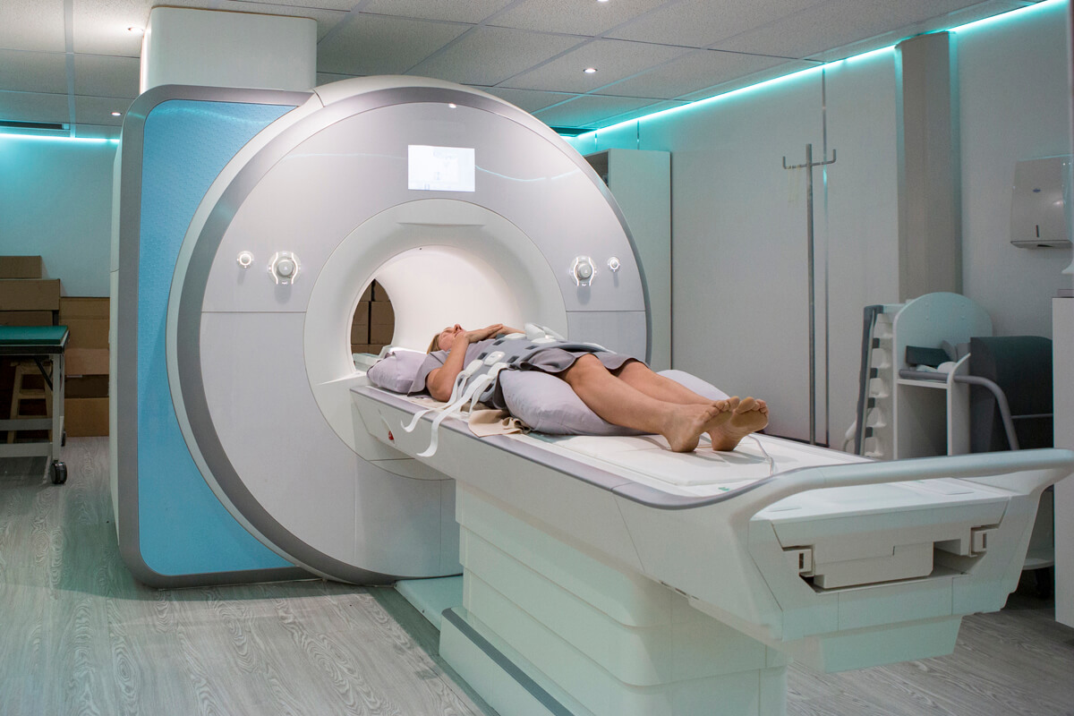
Practice: Tell and Collect Stories of Impact
@ZACHMERCURIO
Notes:
Individual approach and disposition.

Slide 18
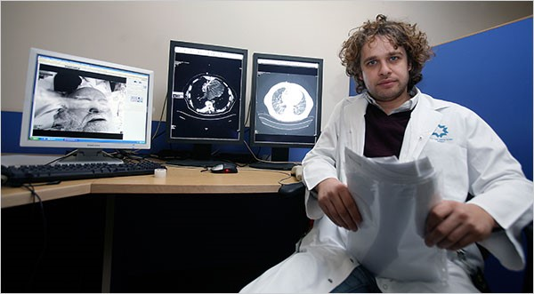
Practice: Tell and Collect Stories of Impact
Source: Radiological Society of North America, 2005
@ZACHMERCURIO

Slide 19
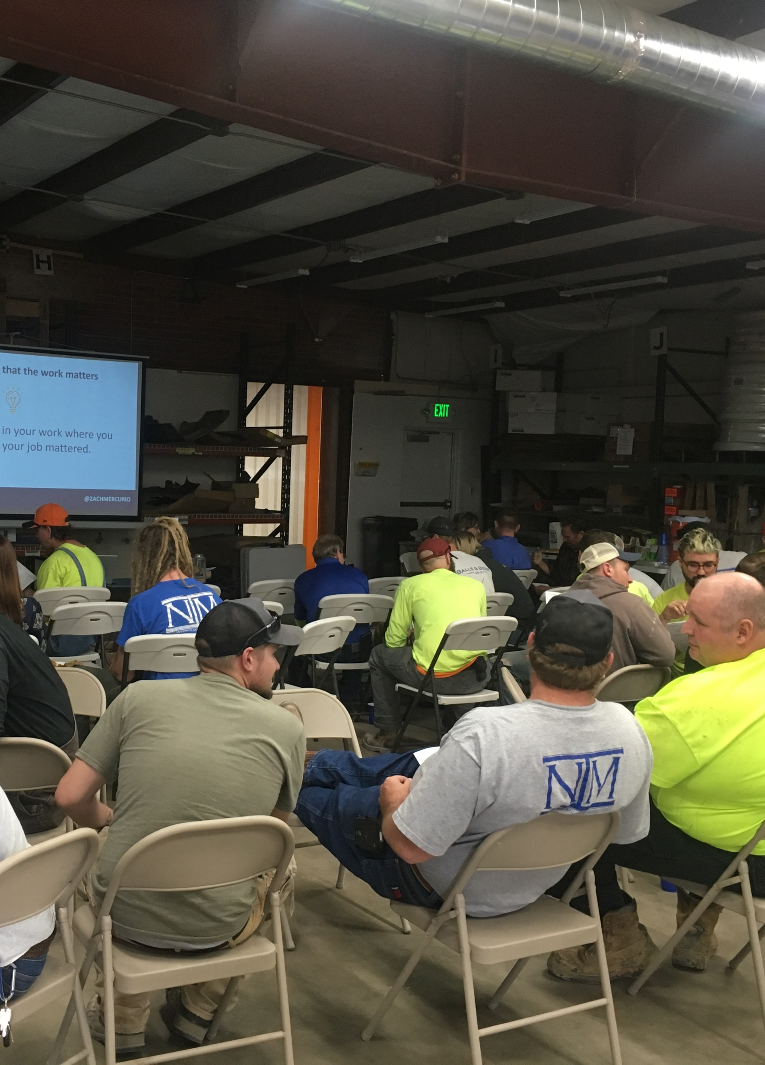
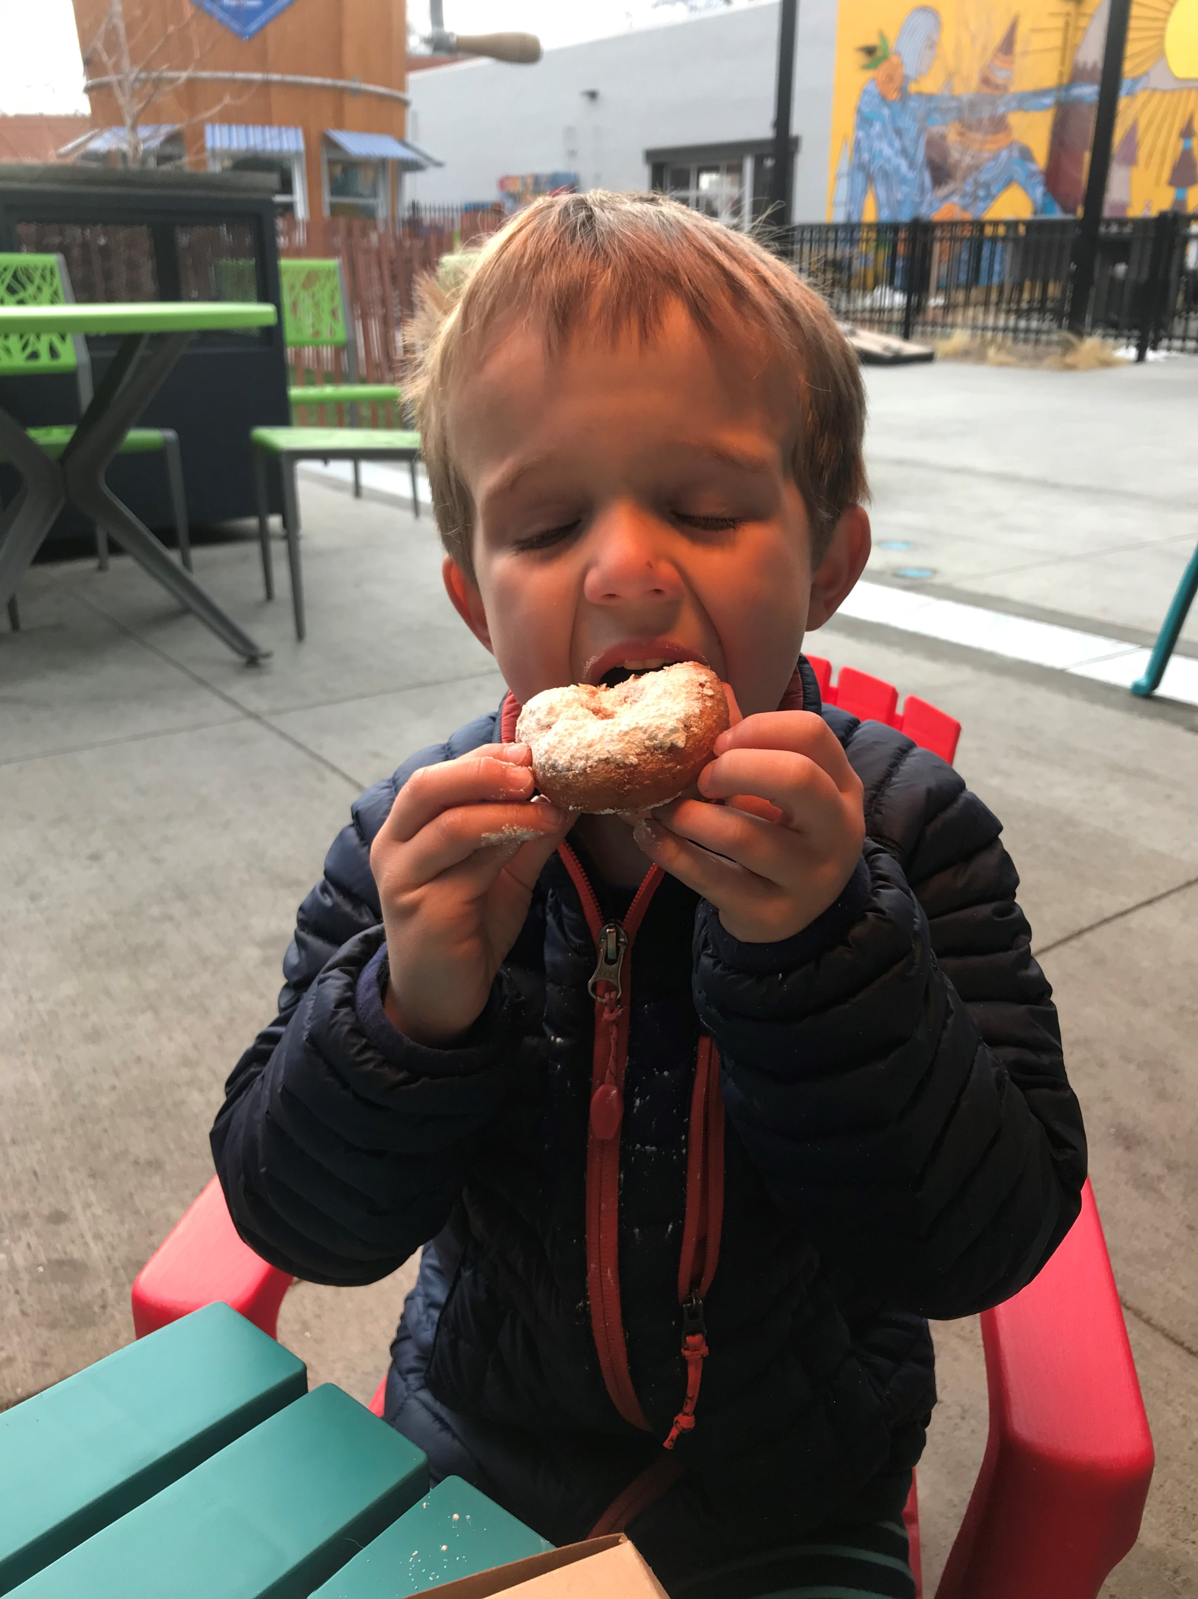
@ZACHMERCURIO
Notes:
Make the link clear, daily.

Slide 20
Practice: Design Jobs for Meaningfulness
How does it affect a human being?
What end outcome does it make possible?
Which of my strengths can I use more to do it?
Sources: Hackman & Oldham, 1976, 1980; Fried & Ferris, 1987
@ZACHMERCURIO

Slide 21
Practice: Purposeful Affirmation and Gratitude
Don’t just tell people “good job,” regularly show people the difference they make.
@ZACHMERCURIO
@ZACHMERCURIO
Notes:
Make the link clear, daily.

Slide 22
Practices of Purposeful Leaders
Show people how they matter
Communicate and connect people to your purpose
Practice your purpose
@ZACHMERCURIO

Slide 23
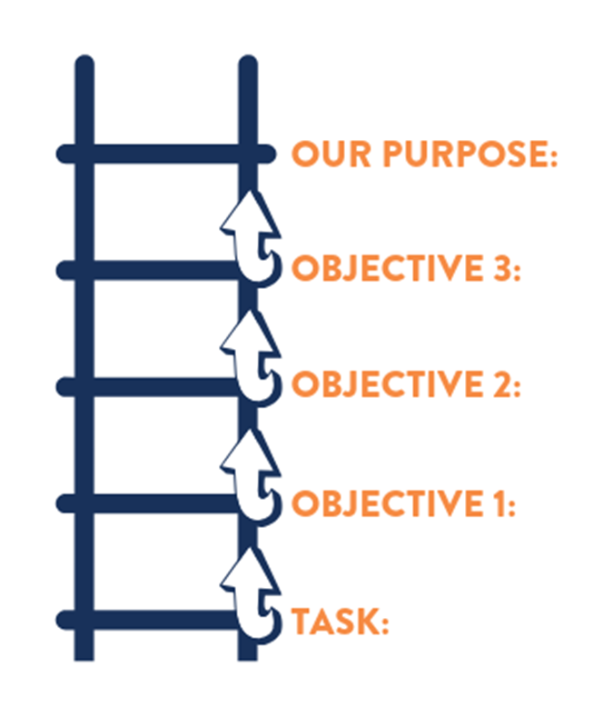
Sources: Carton, 2017
@ZACHMERCURIO

Slide 24
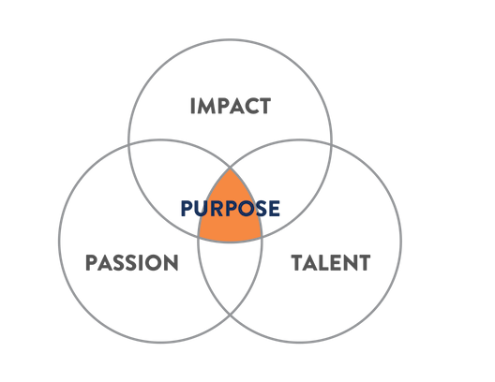
Practice: State and Communicate Your Purpose
@ZACHMERCURIO

Slide 25
Practice: State and Communicate Your Purpose
@ZACHMERCURIO

Slide 26
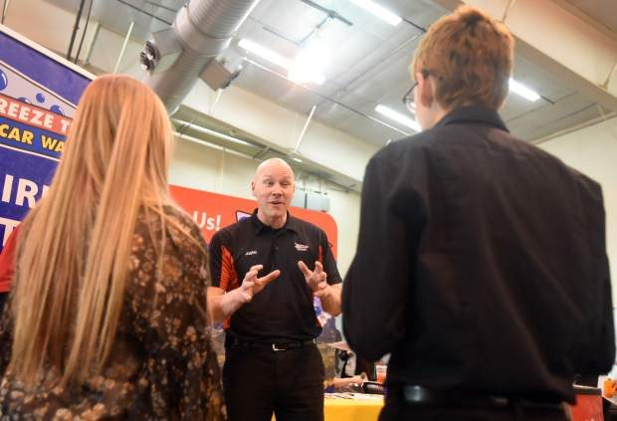
“…prepare people for the future and provide for the community.”
@ZACHMERCURIO

Slide 27
KPI: 80% of all employees retained for at least one year.
Over 1 million cars washed per year.
The result of the purpose, not the purpose.
@ZACHMERCURIO

Slide 28
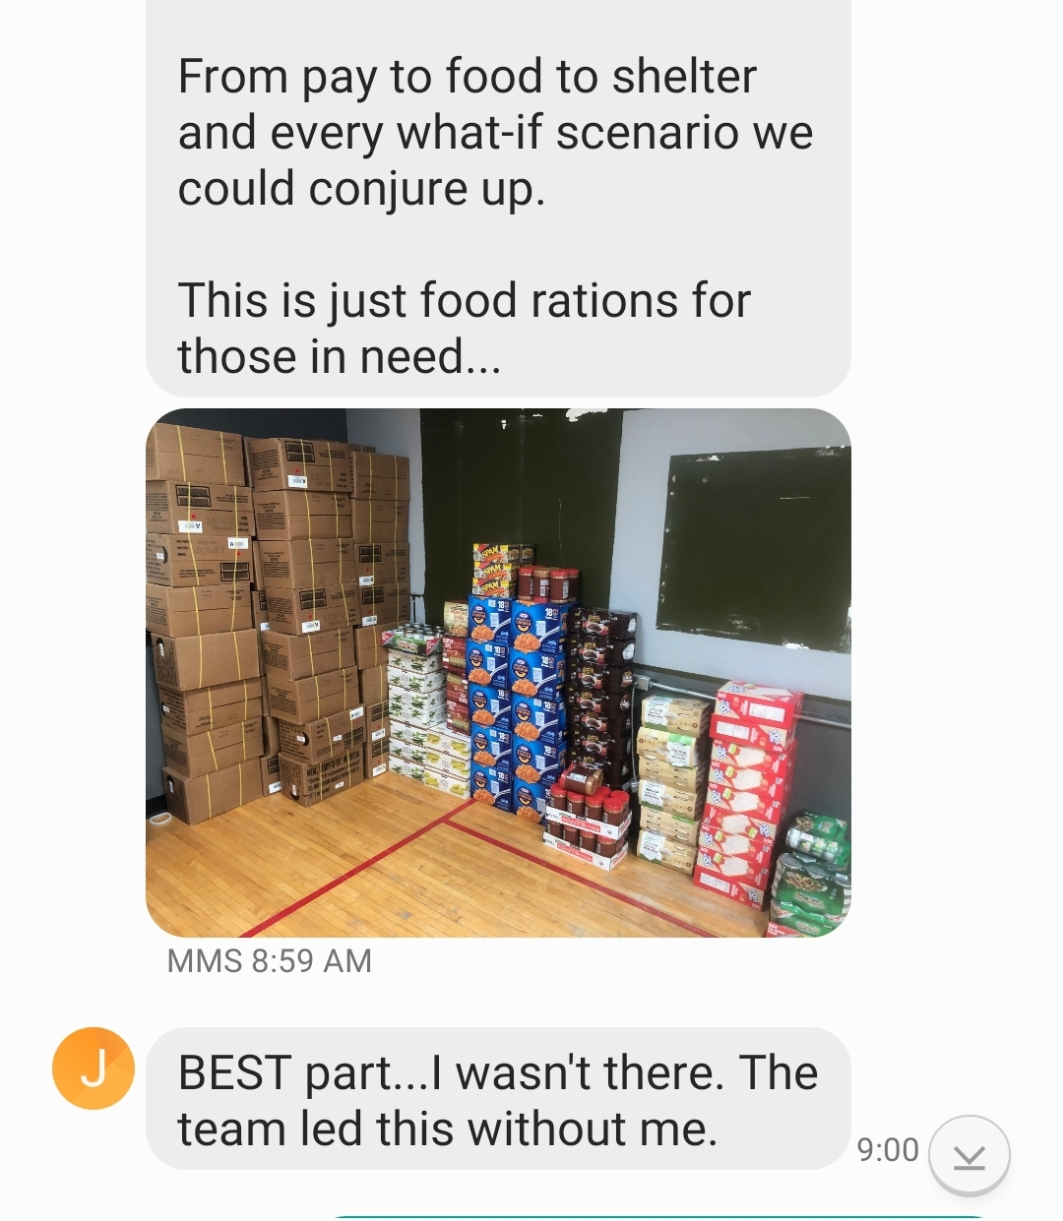
@ZACHMERCURIO

Slide 29
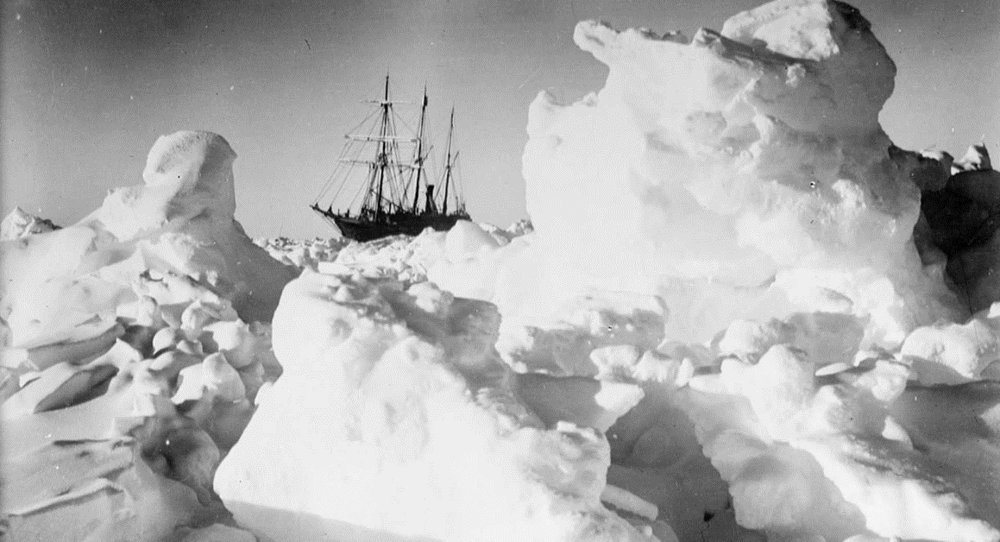
Practice: Laddering
Sources: Koehn, 2017
@ZACHMERCURIO

Slide 30
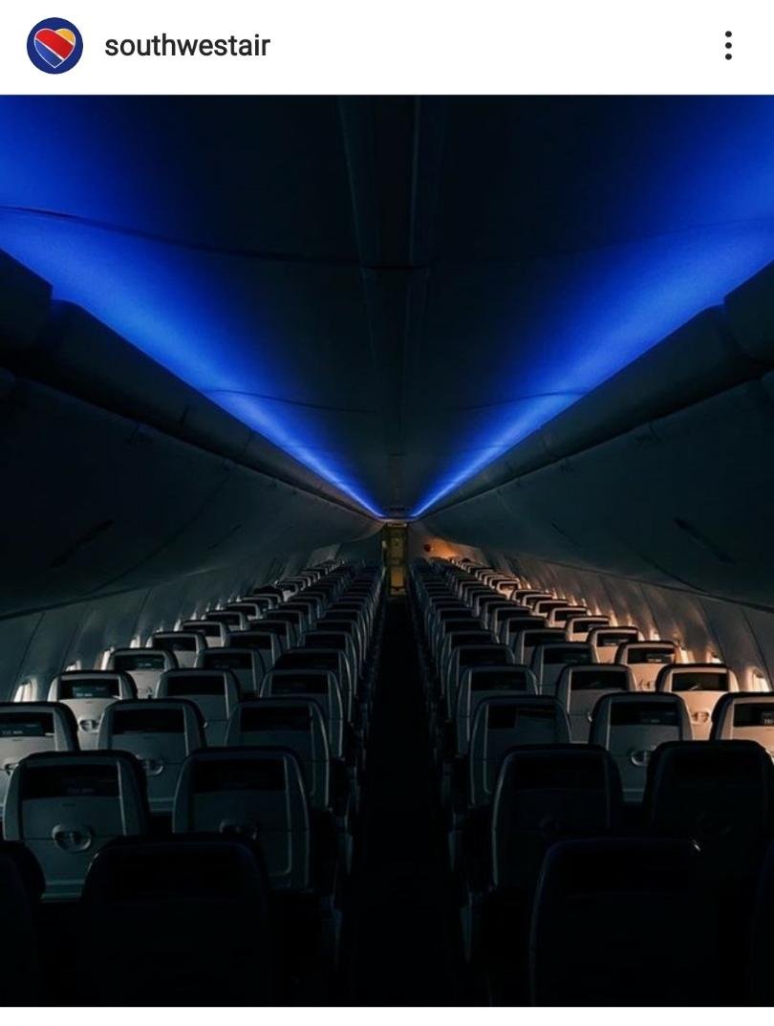
Critical care pulmonologist travelling to volunteer in California.
@ZACHMERCURIO

Slide 31
Practices of Purposeful Leaders
Show people how they matter
Communicate and connect people to your purpose
Practice your purpose
@ZACHMERCURIO

Slide 32
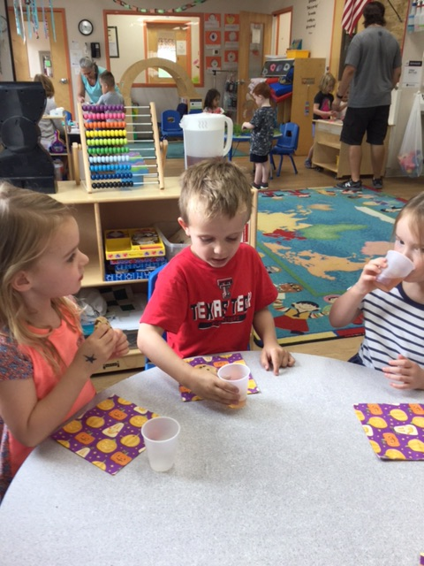
Who did you help?
Who helped you?
@ZACHMERCURIO

Slide 33
What You Can Do Right Now
Find the stories that remind you and your stakeholders why you need to survive. Share them. Repeat them in your mind.
Meet with your team. Tell them what’s keeping you up at night. Ask them for their help. Remind each person how their job matters.
Ask your team: In what 3 ways will moving through this crisis/change well help us better deliver our purpose? What will we feel, what will we become, what will we be able to do?
Sources: Koehn, 2017
@ZACHMERCURIO

Slide 34
“Between stimulus and response there is space.
In that space is our power to choose our response.
In our response lies our growth and our freedom.”
Viktor Frankl Author, Man’s Search for Meaning, concentration camp survivor
@ZACHMERCURIO
Notes:
Purposeful leaders create the space to respond positively.

Slide 35
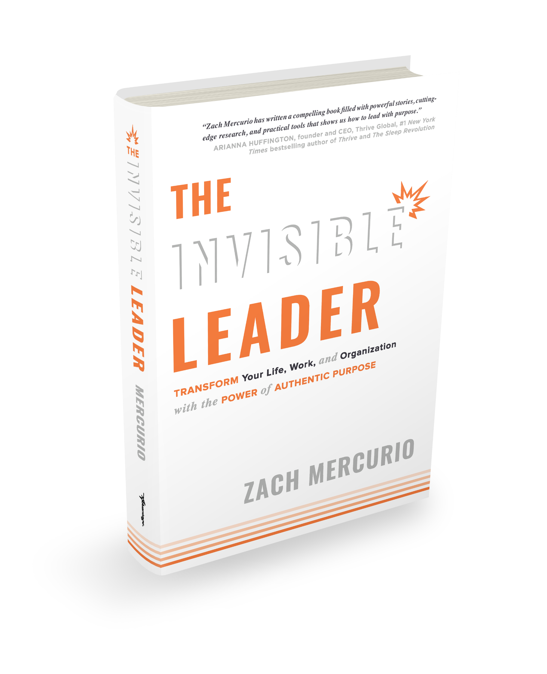
Text ZACH to 55444
@ZACHMERCURIO
@ZACHMERCURIO
@ZMERCURIO
@ZACHMERCURIO

